Slide 1

PROGRAMMING (Introduction)
Sunil Nadella
M.Sc.,M.Tech., M.Phil.,PGDCS.,(Ph.D)
UGC NET (Computer Science & Applications)
AP SET (Computer Science & Applications )
TS & AP SET (Mathematical Sciences)
Gold Medalist from Andhra University
http://sunilnadella.googlepages.com

Slide 2
Introduction to Data Structures

Slide 3
Introduction -Data Structures
Computer Science is the study of algorithms or more precisely its formal ( or mathematical) properties, hardware and linguistic realizations along with its applications.
-Norman E Gibbs
-Allen B Tucker
What is computer?
What is computing?
Data – raw facts
Information - organized data
Knowledge - hidden facts
Data type – method of interpreting bit patterns
Basic data types - integer, float, double, character etc.,
Why we need arrays, structures , unions files and other data structures
Why data is to be structured?
Efficient storage and retrieval of data is important in computing

Slide 4
Introduction -Data Structures
Why data is to be structured?
Efficient storage and retrieval of data is important in computing
What is data structure
Linear & non linear data structures
Stack, Queue, Linked List, tree, graph etc.,
Data Structure – is a collection of data elements whose organization is characterized by accessing functions that are used to store and retrieve individual data elements
Abstract Data Type (ADT) – is a tool to specify the logical properties of the data type
ADT has two parts viz., value definition and operation definition
Abstract Data Type
value Definition
Definition Clause
Conditional clause
Operation Definition
Function
Precondition
postcondition

Slide 5
Introduction -Data Structures
Abstract Data Type
value Definition
Definition Clause - states the contents of the data type.
Conditional clause – defines any condition that applies to the data type.
(definition clause is mandatory while condition clause is optional)
Operation Definition
Function – defines the role of the operation
Precondition – specifies any restrictions that must be satisfied before the operation can be applied
Postcondition – specifies any condition that may apply as a pre-requisite for the operation definition

Slide 6
Introduction -Data Structures
There are two ways of implementation of Data Structures
Static implementation – the memory is allocated at the compile time.
Dynamic implementation - the memory is allocated as and when required during the runtime
Algorithm
Recursive
Non-recursive
Program
Analysis of algorithm / Complexity of an Algorithm
Time complexity
Space complexity
Asymptotic notations
Big oh
Big theta
Big Omega
Small oh
Small theta
tilda

Slide 7
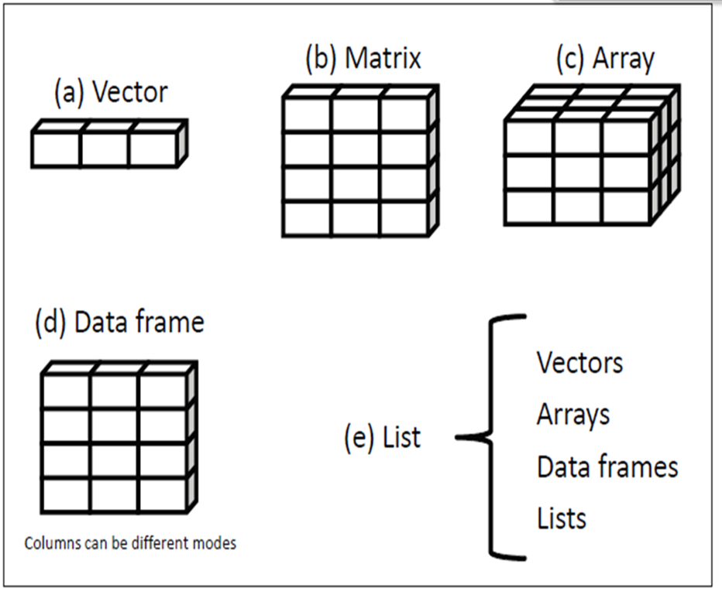
Data Structures in R

Slide 8
About R language

Slide 9
R is a programming language and software environment for statistical analysis, Graphics representation and reporting R was created by Ross Ihaka & Robert Gentleman in Department of Statistics of the University of Auckland, Auckland, New Zealand, in 1993
This programming language was named R, based on the first letter of first name of the two R authors (Robert Gentleman and Ross Ihaka)
A large group of individuals has contributed to R by sending code and bug reports.
Since mid-1997 there has been a core group (the "R Core Team") who can modify the R source code archive.

Slide 10
R is an interpreted computer language.
R language allows branching and looping as well as modular programming using functions.
R language allows integration with the procedures written in the C, C++, .Net, Python or FORTRAN languages for efficiency.
R is freely available under the GNU General Public License, and pre-compiled binary versions are provided for various operating systems like Linux, Windows and Mac.
R is free software distributed under a GNU-style copy left, and an official part of the GNU project called GNU S.

Slide 11
Downloading & installing
Windows
1. Open http://www.r-project.org/ in your browser.
2. Click on “CRAN”. You’ll see a list of mirror sites, organized by country.
3. Select a site near you.
4. Click on “Windows” under “Download and Install R”.
5. Click on “base”.
6. Click on the link for downloading the latest version of R (an .exe file).
7. When the download completes, double-click on the .exe file and answer the usual questions.

Slide 12
Downloading & installing
OS X
1. Open http://www.r-project.org/ in your browser.
2. Click on “CRAN”. You’ll see a list of mirror sites, organized by country.
3. Select a site near you.
4. Click on “MacOS X”.
5. Click on the .pkg file for the latest version of R, under “Files:”, to download it.
6. When the download completes, double-click on the .pkg file and answer the usual questions.

Slide 13
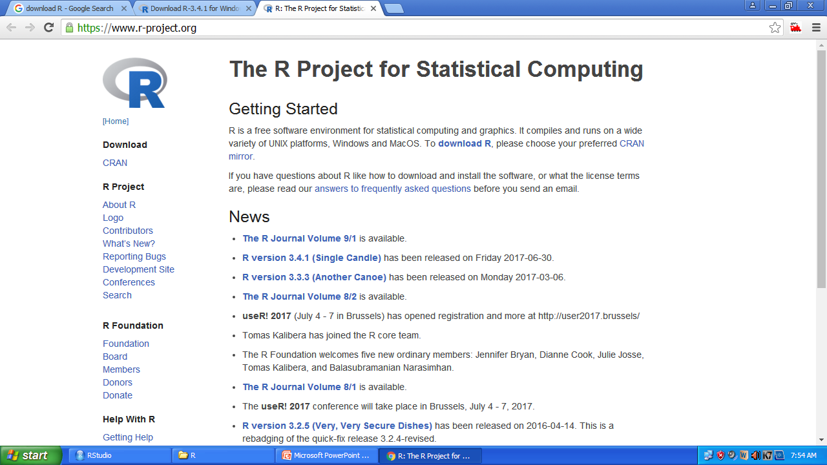

Slide 14
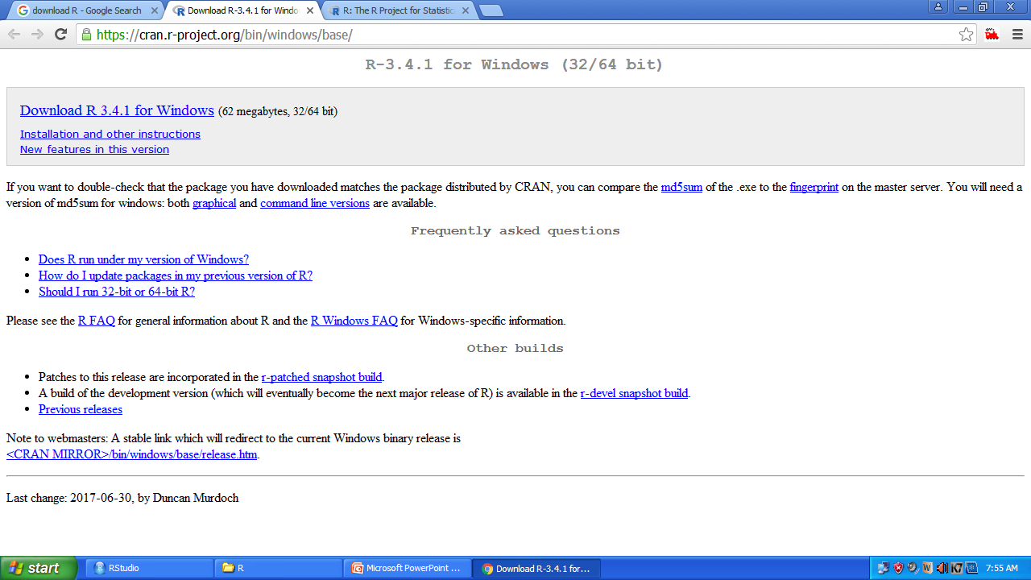

Slide 15
Starting R
Windows
Click on Start → All Programs → R; or double-click on the R icon on your desktop
(assuming the installer created an icon for you).
OS X
Either click on the icon in the Applications directory or put the R icon on the dock
and click on the icon there. Alternatively, you can just type R on a Unix command
line in a shell.
Linux or Unix
Start the R program from the shell prompt using the R command (uppercase R).

Slide 16
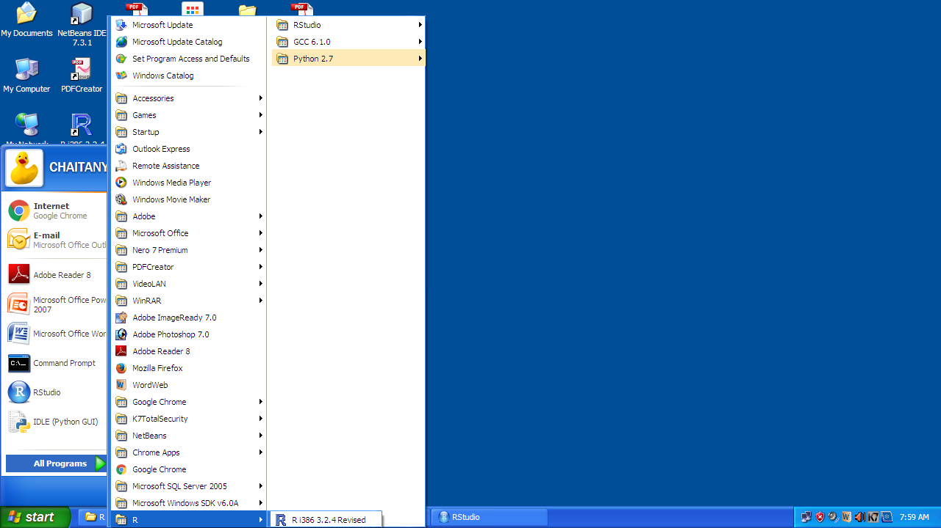

Slide 17
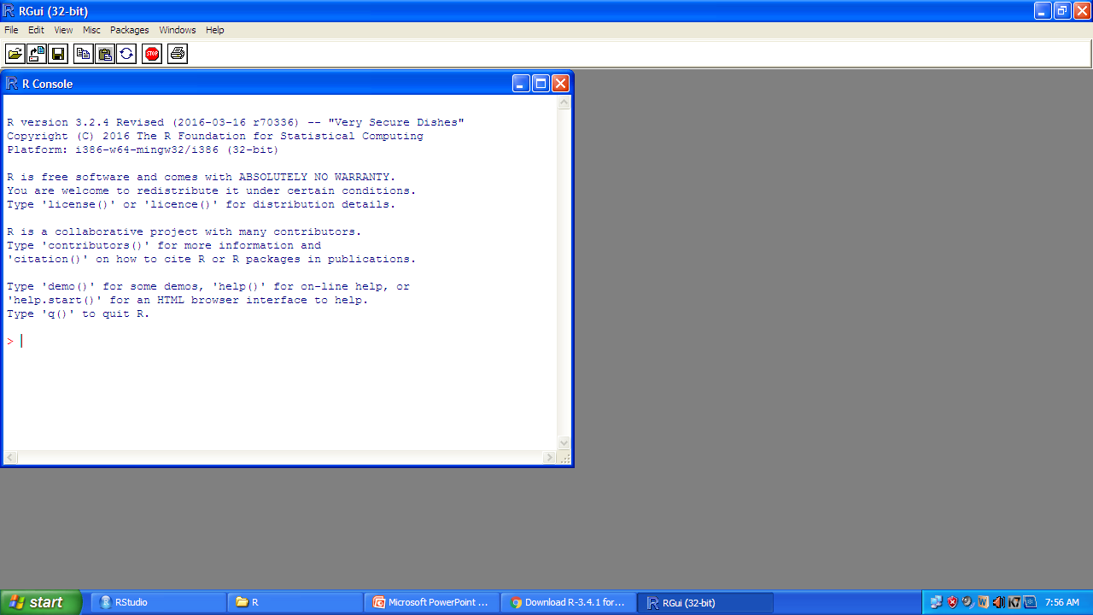

Slide 18
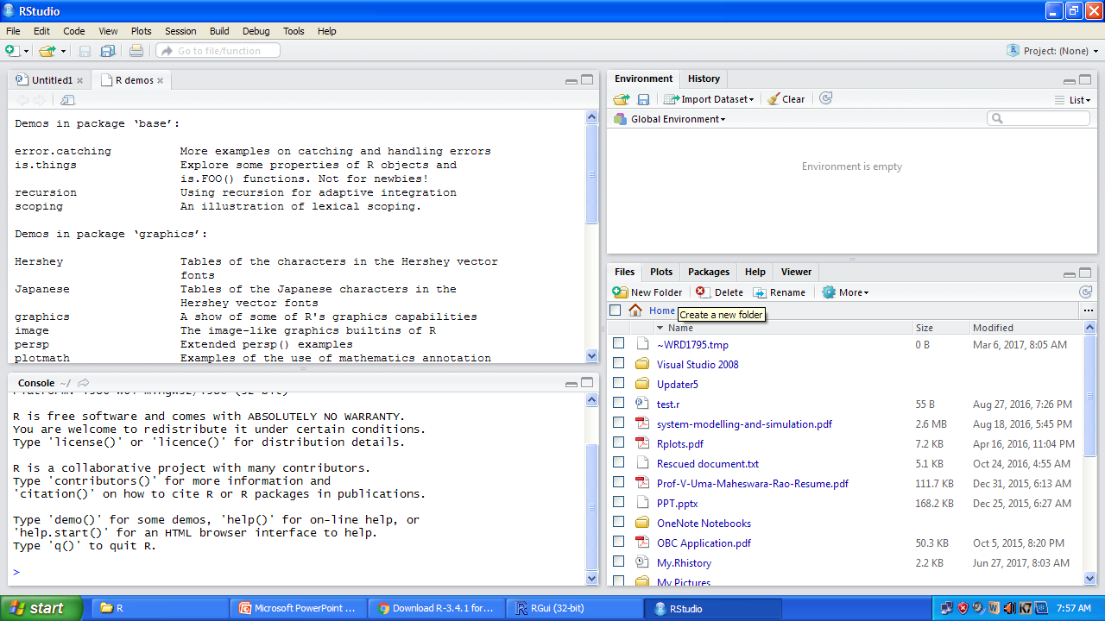

Slide 19
Entering Commands in R
R prompts you with “>”. To get started, just treat R like a big calculator:
enter an expression, and R will evaluate the expression and print the result:
> 1+1
[1] 2
The computer adds one and one, giving two, and displays the result.

Slide 20
Entering Commands in R
It’s easy to mistype commands, and retyping them is tedious and frustrating. So R includes command-line editing to make life easier. It defines single keystrokes that let you easily recall, correct, and re execute your commands. My own typical command line interaction goes like this:
1. I enter an R expression with a typo.
2. R complains about my mistake.
3. I press the up-arrow key to recall my mistaken line.
4. I use the left and right arrow keys to move the cursor back to the error.
5. I use the Delete key to delete the offending characters.
6. I type the corrected characters, which inserts them into the command line.
7. I press Enter to reexecute the corrected command

Slide 21
Command line editing
Labeled key | Ctrl key combination | description
Up arrow | Ctrl + P | Recall previous command by moving backward through the history of commands
Down arrow | Ctrl +n | Move forward through the history of commands
Backspace | Ctrl + h | Delete the character to the left of cursor
Delete(del) | Ctrl + d | Delete the character to the right of cursor
Home | Ctrl + A | Move cursor to the start of the line
end | Ctrl + E | Move cursor to the end of the line
Right arrow | Ctrl +F | Move cursor right (forward) one character
Left arrow | Ctrl + B | Move cursor left (back) one character
 | Ctrl +K | Delete every thing from the cursor position to the end of the line
 | Ctrl + U | Clear the whole darn line and start over
Tab |  | Name completion (on some platforms)

Slide 22
Exiting from R
Windows
Select File → Exit from the main menu; or click on the red X in the upper-right corner of the window frame.
OS X
Press CMD-q (apple-q); or click on the red X in the upper-left corner of the window frame.
Linux or Unix
At the command prompt, press Ctrl-D.
On all platforms, you can also use the q function (as in quit) to terminate the program.
> q()
Note the empty parentheses, which are necessary to call the function.

Slide 23
Exiting from R
Whenever you exit, R asks if you want to save your workspace. You have three choices:
• Save your workspace and exit.
• Don’t save your workspace, but exit anyway.
• Cancel, returning to the command prompt rather than exiting.
If you save your workspace, then R writes it to a file called .RData in the current working directory. This will overwrite the previously saved workspace, if any, so don’t save if you don’t like the changes to your workspace (e.g., if you have accidentally erased critical data).

Slide 24
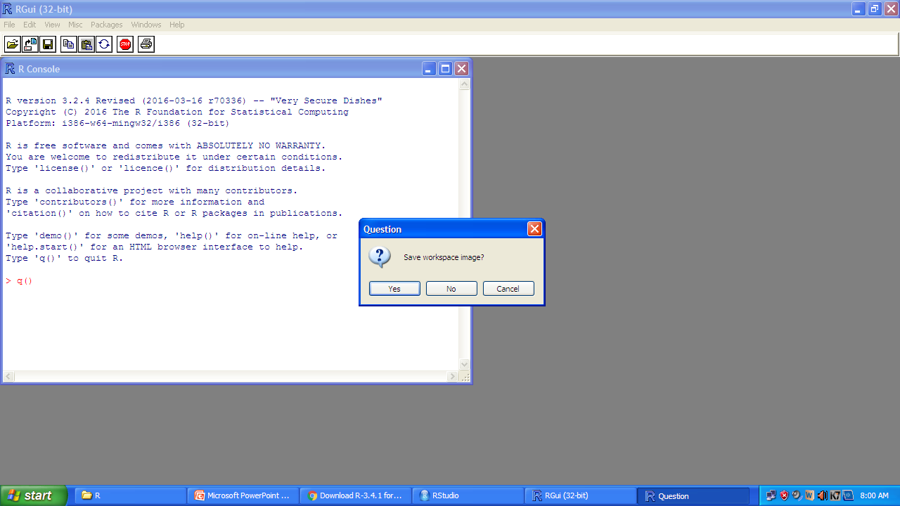

Slide 25
Interrupting R
You want to interrupt a long-running computation and return to the command prompt without exiting R.
Windows or OS X
Either press the Esc key or click on the Stop-sign icon.
Linux or Unix
Press Ctrl-C. This will interrupt R without terminating it.
Interrupting R can leave your variables in an indeterminate state, depending upon how far the computation had progressed. Check your workspace after interrupting.

Slide 26
Viewing the supplied documentation
You want to read the documentation supplied with R.
Use the help.start function to see the documentation’s table of contents
> help.start()
From there, links are available to all the installed documentation.

Slide 27
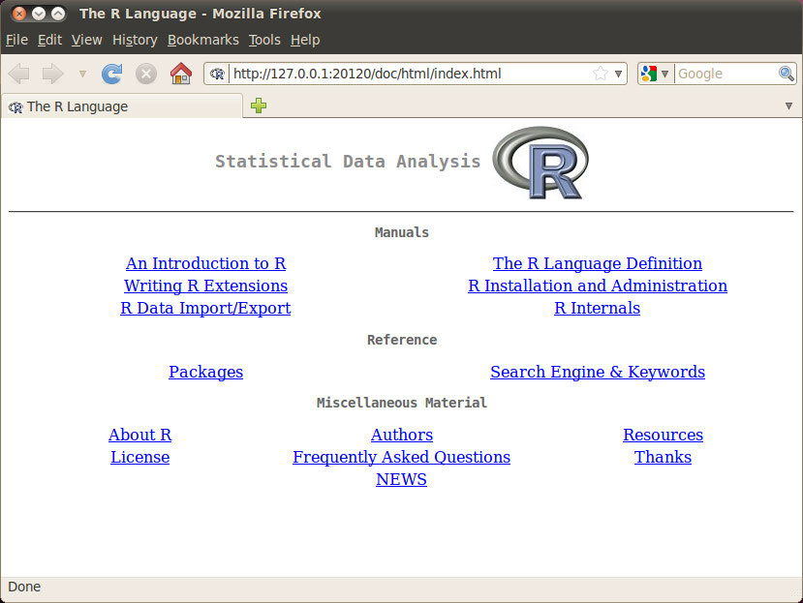
Viewing the supplied documentation

Slide 28
Viewing the supplied documentation
The two links in the Reference section are especially useful:
Packages
Click here to see a list of all the installed packages, both in the base packages and the additional, installed packages. Click on a package name to see a list of its functions and datasets.
Search Engine & Keywords
Click here to access a simple search engine, which allows you to search the documentation by keyword or phrase. There is also a list of common keywords, organized by topic; click one to see the associated pages.

Slide 29
Getting help on a function
You want to know more about a function that is installed on your machine.
Use help to display the documentation for the function
>help(functionname) or
>?mean
Use args for a quick reminder of the function arguments
> args(functionname)
Use example to see examples of using the function
> example(functionname)

Slide 30
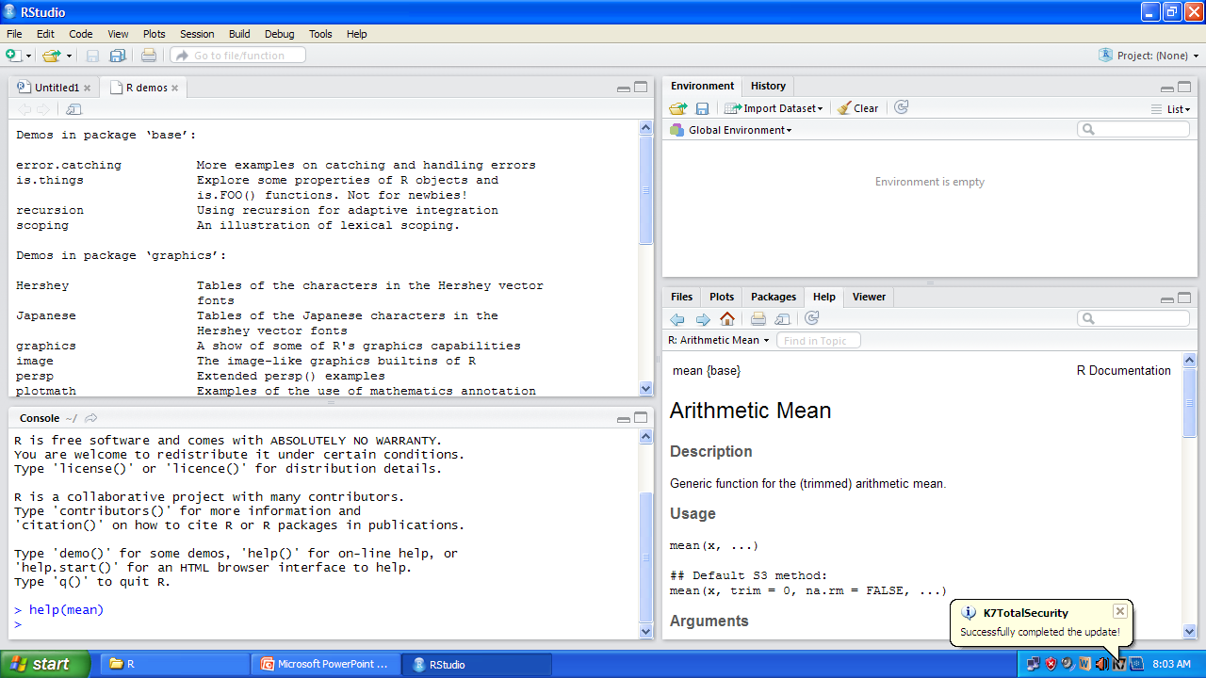

Slide 31
Searching the supplied documentation
You want to know more about a function that is installed on your machine, but the help function reports that it cannot find documentation for any such function. Alternatively, you want to search the installed documentation for a keyword.
Use help.search to search the R documentation on your computer
> help.search("pattern")
A typical pattern is a function name or keyword. Notice that it must be enclosed in quotation marks.
For your convenience, you can also invoke a search by using two question marks (in which case the quotes are not required)
> ??pattern

Slide 32
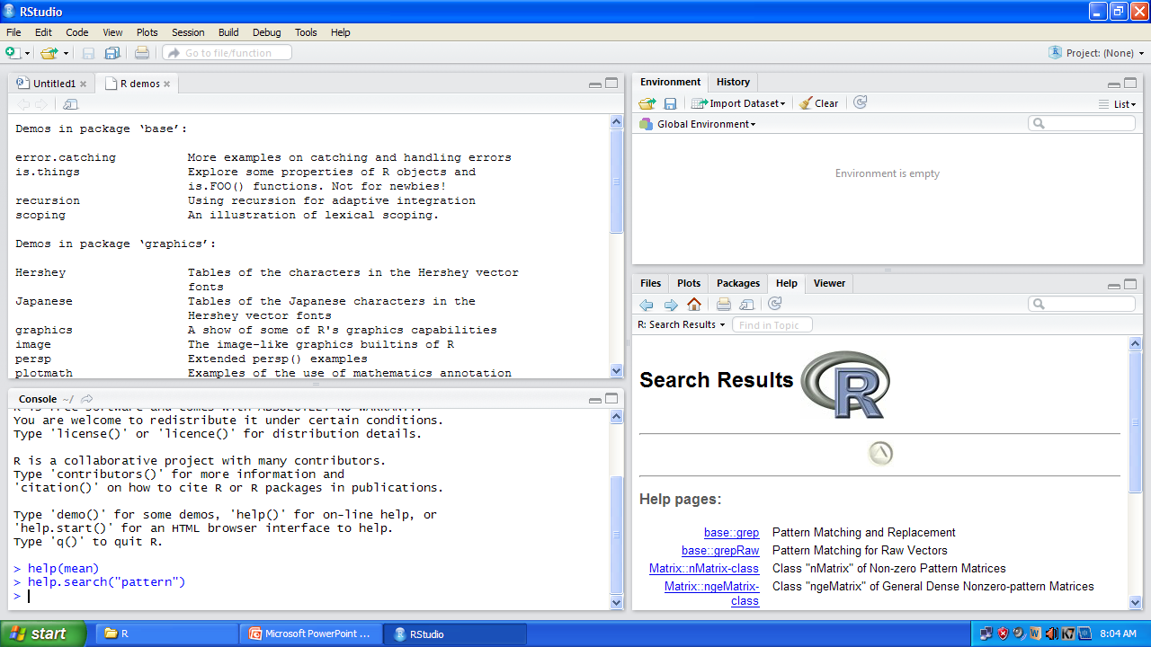

Slide 33


